Slide 1

SMART HOSTEL
ENERGY
MANAGEMENT
by Bharathi Selvaraj

Slide 2
modules
what is SHEMS?
Module 1: Authentication and Role Management
- Main Classes:
1. UserAuthController
2. AuthService
3. UserRepository
Smart Device Management
- Main Classes:
1. Device
2. DeviceController
3. DeviceService
4. DeviceRepository
The Smart Home Energy Management System (SHEMS) is a Java-powered web platform that helps monitor, analyze, and manage energy usage within a household.
It continuously observes the electricity consumption of various devices, estimates upcoming usage patterns, and offers guidance to lower overall power costs.
SHEMS includes an interactive dashboard that displays live energy data, highlights peak consumption periods, provides cost projections, and delivers practical tips for improving energy efficiency.
Real Time Energy Tracking
- Main Classes:
1. UsageLog
2. EnergyTrackingController
3. EnergyTrackingService
4. UsageRepository
Analytics Dashboard
- Main Classes:
1. AnalyticsController
2. AnalyticsService
3. ChartGenerator
4. AnalyticsRepository
Scheduling and Automation
- Main Classes:
1. Schedule
2. SchedulerController
3. SchedulerService
4. NotificationService
5. SchedulerRepository
Recommendation System
- Main Classes:
1. Recommendation
2. RecommendationController
3. RecommendationService
2

Slide 3
FEATURES OF MODULE 1: AUTHENTICATION & ROLE MANAGEMENT
FEATURES OF MODULE 2: SMART DEVICE MANAGEMENT
  Handles secure user login and registration through UserAuthController
  Validates user credentials using AuthService
  Enforces role-based access control before system usage
  Stores and retrieves user details via UserRepository
  Separates responsibilities using Controller–Service–Repository layers
  Ensures only authorized users can access system features
  Manages all smart home devices using the Device model
  Accepts device control requests through DeviceController
  Applies business logic in DeviceService
  Updates and stores device data using DeviceRepository
  Maintains real-time device status (ON / OFF)
  Integrates with Module 1 for secure device access
3

Slide 4
FEATURES OF MODULE 3 – REAL-TIME ENERGY TRACKING
📊 UsageLog
Stores device-wise energy usage data
Maintains timestamp and power consumption details
⚙️ EnergyTrackingService
Calculates energy usage
Applies business logic before saving data
🎮 EnergyTrackingController
Handles energy tracking requests
Logs usage when device state changes
🗄️ UsageRepository
Saves and retrieves energy usage records
Ensures data consistency
FEATURES OF MODULE 4 – ANALYTICS DASHBOARD
📊 Energy Usage Analysis
Calculates total, daily, and monthly energy consumption
📈 Trend Visualization
Displays usage trends using charts and graphs
💰 Cost Estimation
Estimates electricity cost based on energy usage
🏢 High Consumption Identification
Identifies rooms or devices with high energy usage
🔐 Secure Access
Provides analytics access only to authorized admins
4

Slide 5
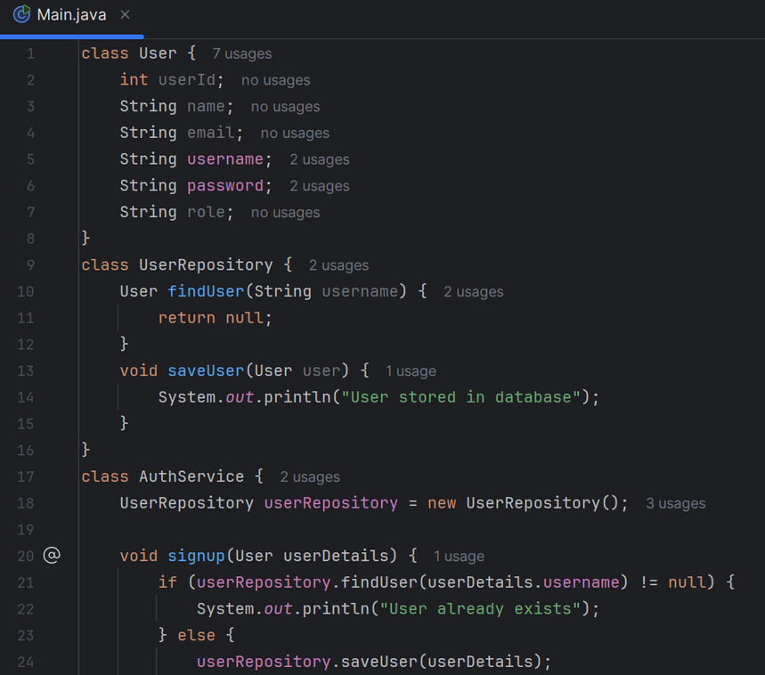
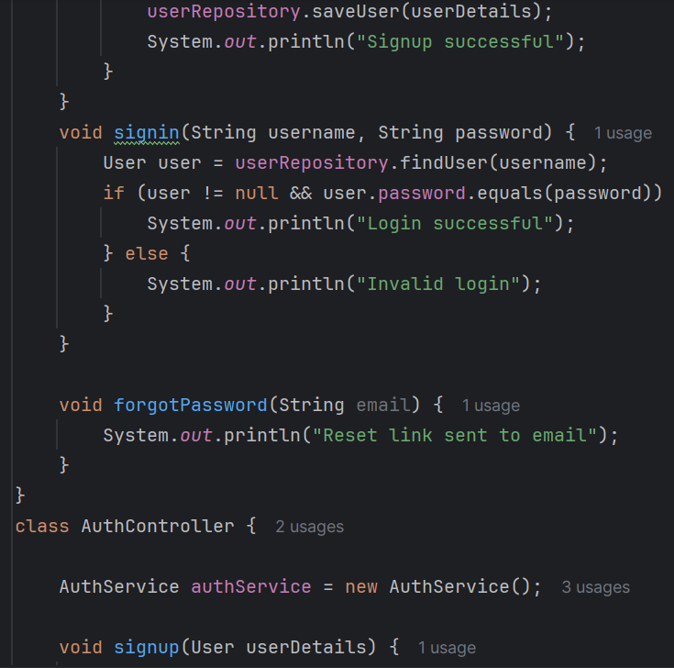
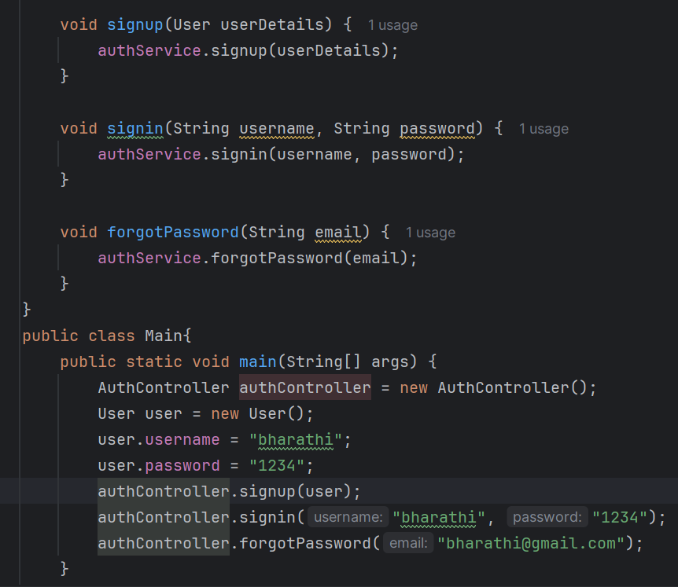
module 1
5

Slide 6
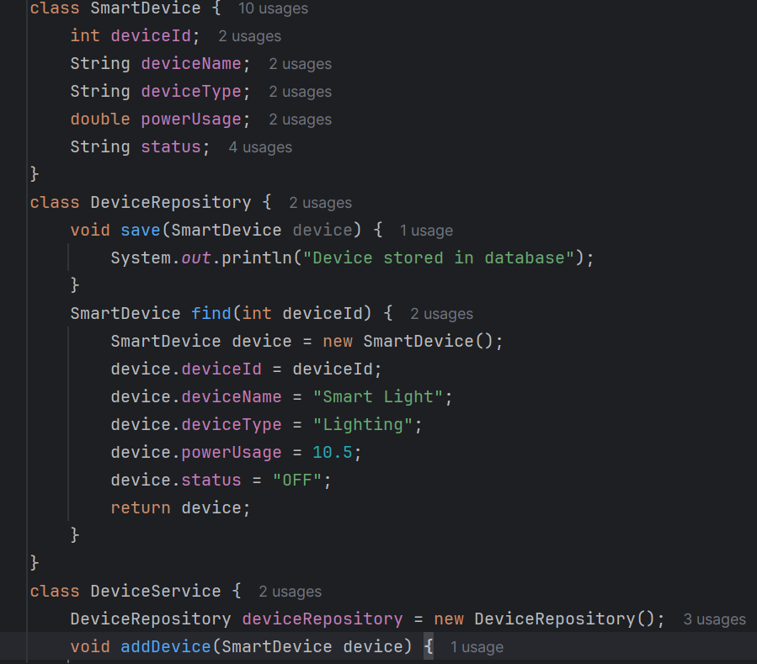
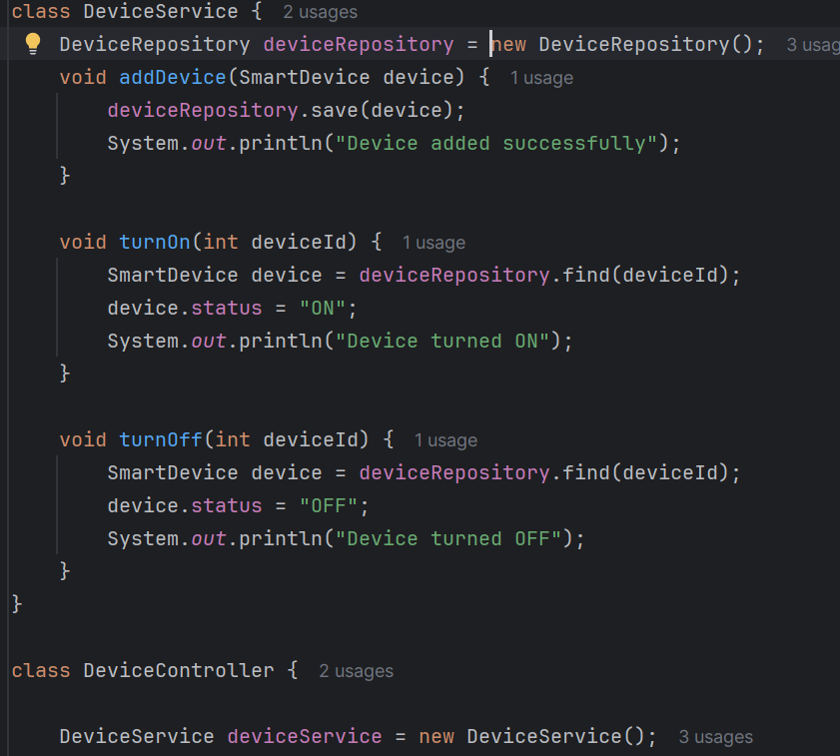
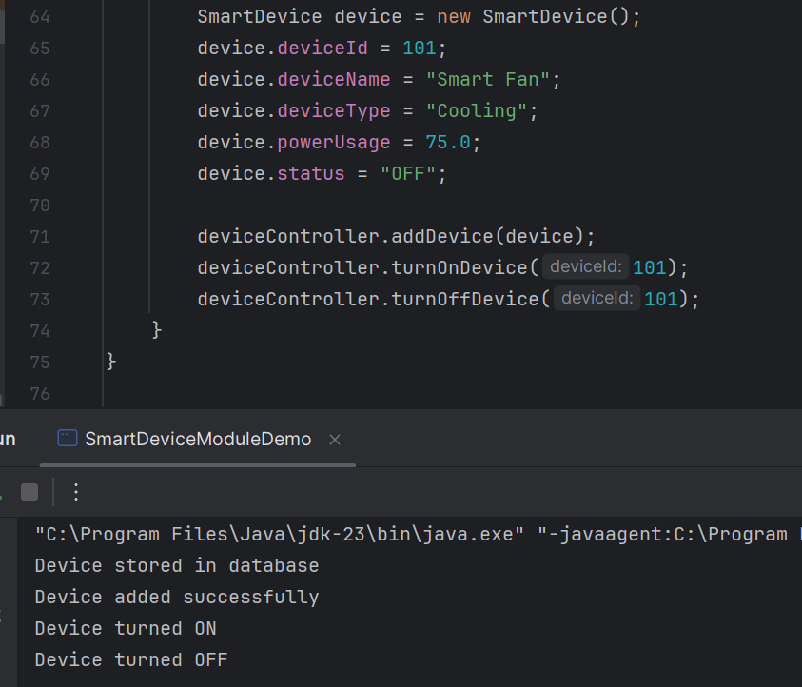
module 2
6

Slide 7
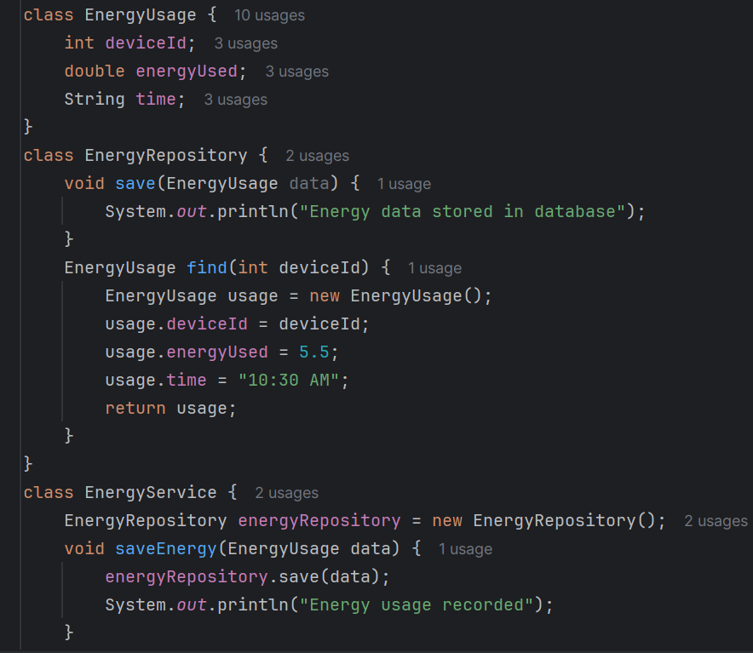
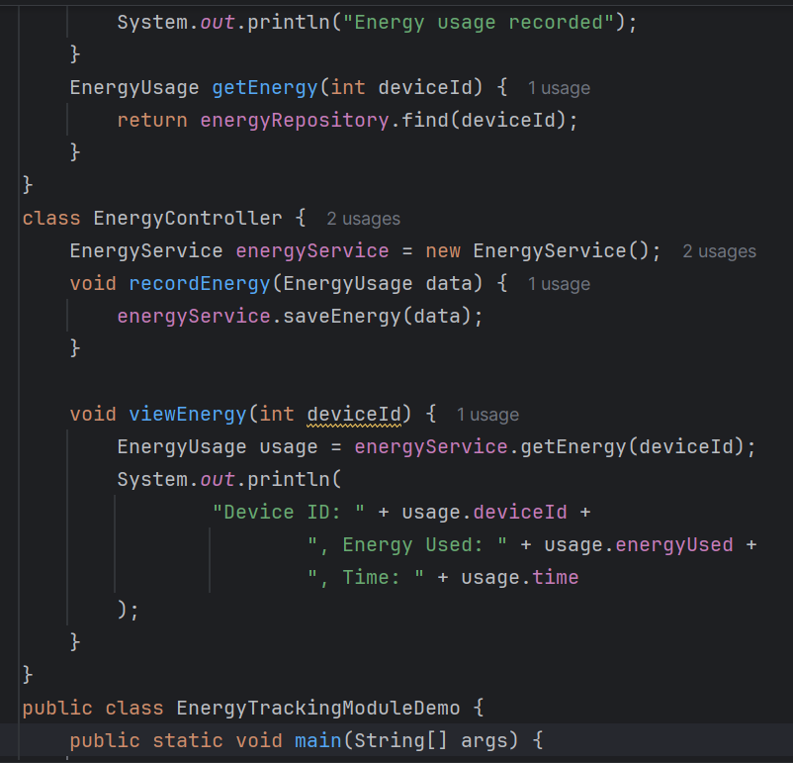
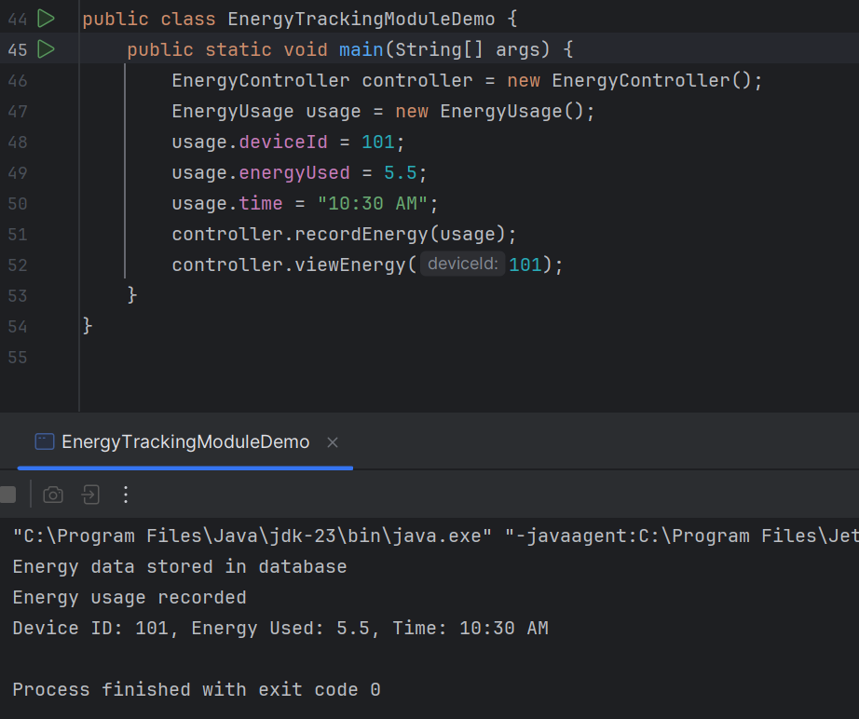
functioning of module 3
7

Slide 8
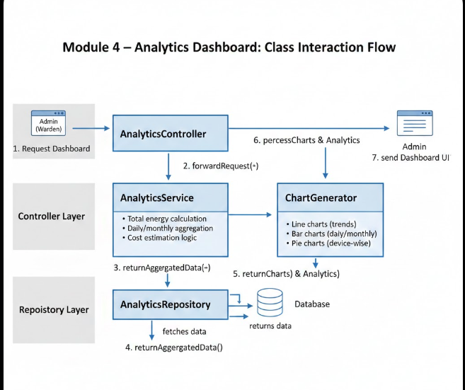
Classes & Their Responsibilities
📊 AnalyticsController
Handles analytics dashboard requests
Acts as the entry point for analytics operations
⚙️ AnalyticsService
Processes and analyzes energy usage data
Calculates totals, trends, and summaries
🗄️ AnalyticsRepository
Retrieves energy usage data from the database
Supports filtered and aggregated queries
📈 ChartGenerator
Converts analytical data into visual charts
Generates graphs for better data interpretation
8

Slide 9
Input to Analytics Dashboard
Data Sources:
Energy usage data from Module 3
Device details from Module 2
User roles from Module 1
Input Type:
Device ID
Timestamp
Power consumption
Usage duration
Why Analytics Dashboard is Needed?
Problem Without Analytics:
Raw energy data is difficult to interpret
No visibility into high-consumption rooms or blocks
Decision-making is manual and inaccurate
Solution with Analytics Dashboard:
Converts usage data into visual insights
Helps identify wastage patterns
Enables data-driven energy management
Output of Analytics Dashboard
Dashboard Displays:
Total energy consumed (kWh)
Daily energy usage
Monthly consumption trend
Active vs inactive devices
Main Classes:
AnalyticsController
AnalyticsService
AnalyticsRepository
ChartGenerator
9

Slide 10
thankyou
10

